Slide 1
First Year Seminar Gender, Violence, Rome
Erika Zimmermann Damer
edamer@richmond.edu
These slides and links available @ https://github.com/erika-zimmermann-damer/Lesley-University-Violence-against-Women-conference

Slide 2
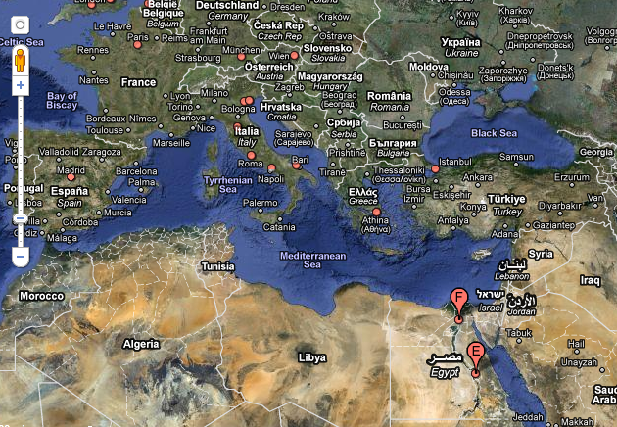
The Mediterranean.

Slide 3
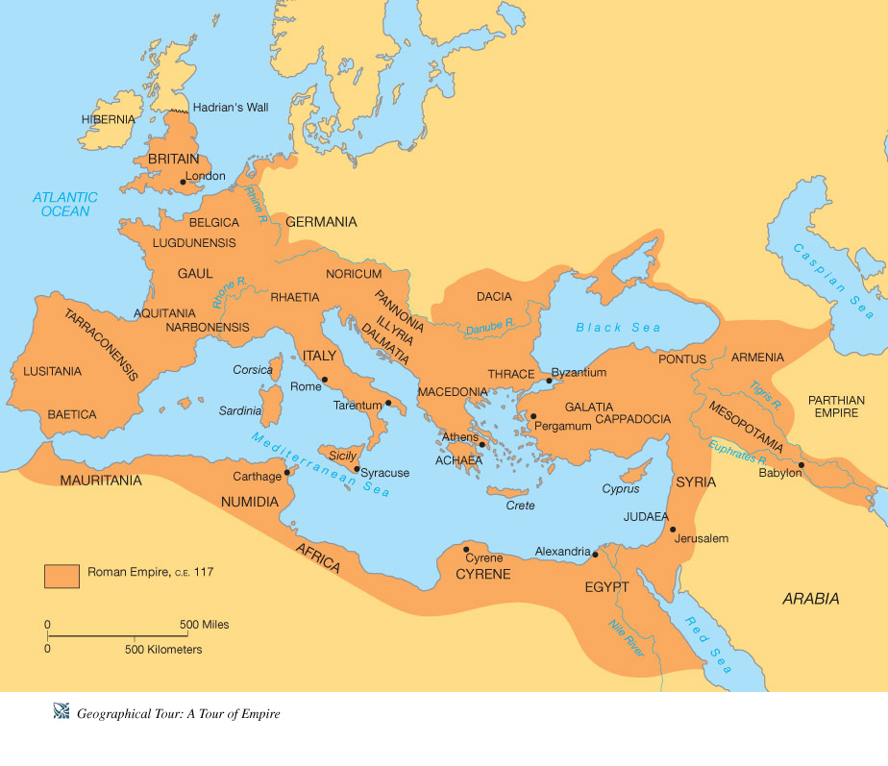
The Roman Empire at its Greatest Extent, c. 100 CE

Slide 4
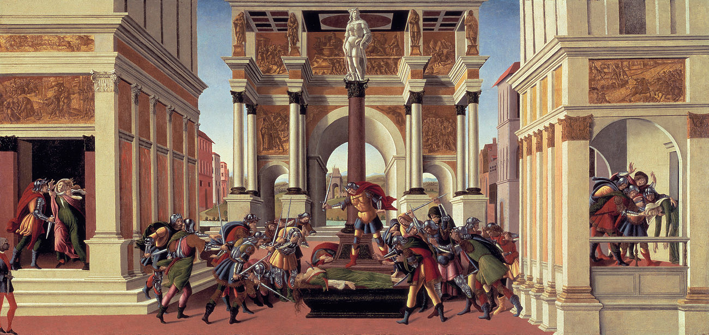
Botticelli’s Death or Suicide of Lucretia (1496-1504), now at the Gardner Museum, Boston

Slide 5
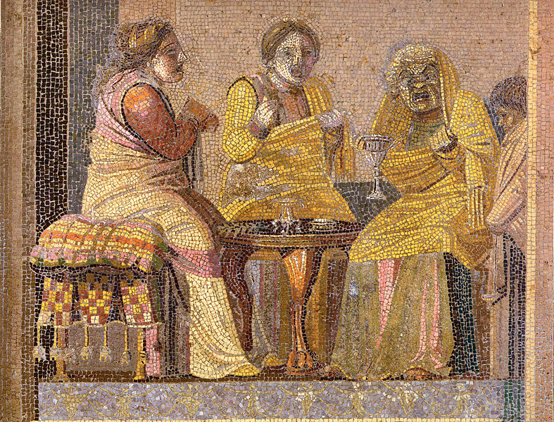
Women in Comic Masks visit a Witch, Mosaic from Pompeii (1st C CE). Now in Naples Archaeological Museum.

Slide 7
Primary Source Readings and Films:
Ovid. Metamorphoses. trans. Stanley Lombardo. (2010)
Roxane Gay. Bad Feminist. (2014)
Transforming a Rape Culture. (2005) Second Edition. Emilie Buchwald, Pamela R. Fletcher, Martha Roth, ed. (TRC)
Plautus, Casina and Curculio
Ovid, the Arts of Love, trans. Julie D. Hejduk. (2015)
Propertius and Tibullus, elegies
Livy, Ab Urbe Condita, Book 1, trans. Valerie Warrior. (2006)
Shakespeare. Titus Andronicus.
Julie Taymor, Titus (1999)
Francis Ford Coppola, the Godfather (1972)
Toni Morrison. Love, A Novel. (2003)

Slide 8
Jackson Katz @ https://www.ted.com/talks/jackson_katz_violence_against_women_it_s_a_men_s_issue
Emilie Buchwald and Pamela Fletcher, “Are We Really Living in a Rape Culture?” (TRC, 5-10)
Kai Johnson, Tanika Lynch, Elizabeth Monroe, and Tracey Wang. 2015 @
http://www.columbiaspectator.com/opinion/2015/04/30/our-identities-matter-core-classrooms/
Mary Beard. 2015. @ https://www.theguardian.com/books/2015/oct/02/mary-beard-why-ancient-rome-matters
Donna Zuckerberg, founding editor of Eidolon Classics Journal. 2015 @http://jezebel.com/how-to-teach-an-ancient-rape-joke-1705749434
Haki Badhubuti, "Becoming Anti-Rapist," (TRC)
Pamela Fletcher, "Whose Body is It, Anyway?" (TRC)
bell hooks, “Seduced by Violence No More” (TRC, 293-300)
Michael Kimmel, “Men, Masculinity, and the Rape Culture” (TRC, 139-158);
Denise McCoskey. 2017 @ https://eidolon.pub/what-would-james-baldwin-do-a778947c04d5

Slide 9
Course Goals & objectives
What role can literature from and influenced by the Roman world play in universities
in the 21st Century? Ovid’s Metamorphoses will guide a careful examination of gender and
violence in the Roman world and in contemporary U.S. universities. Gender, Violence,
Rome will study the ways that Ovid’s Metamorphoses has offered solace and resistance
against gendered violence, and been read as supporting power hierarchies that enable
violence against women and men. In this course, students will meet Roman literature,
and films, drama, and novels inspired by the tradition of Roman culture in
Shakespeare, the Godfather, and in Toni Morrison’s 2003 novel, Love. In its first iteration, this course will center Ovid’s Metamorphoses and the controversies it has spawned on college campuses across the US in the 2010s.
In our learning community, we will take on a few additional objectives: to learn about Roman mythological history, confront the long history of gender violence, its association with political change and unrest in the Roman world, and in receptions of the Roman world. We will look towards new framings, and new modes of living that transcend gender violence, or that live more aware of connections between gender and violence. We will strive to find commonalities between Roman expressions of power, gender, and moments of violence, and contemporary expressions of gender, violence, and power. Throughout the seminar, we will attend to intersecting forms of oppression and opportunity.

Slide 10
Your grade is determined by work from all stages.
The outline, thesis, annotated bibliography is worth 80 points,
the first draft is worth 80 points,
the presentation and peer workshopping is worth 40 points,
the final draft is worth 100 points.

Slide 11
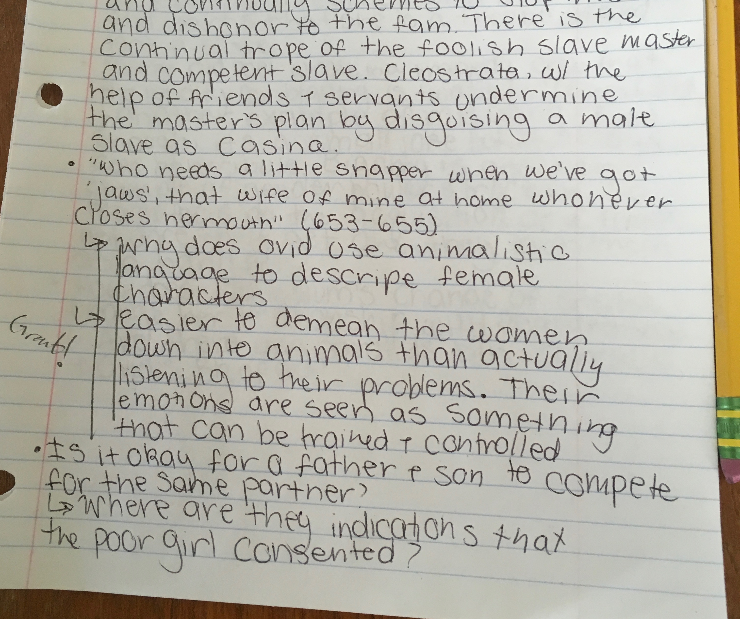
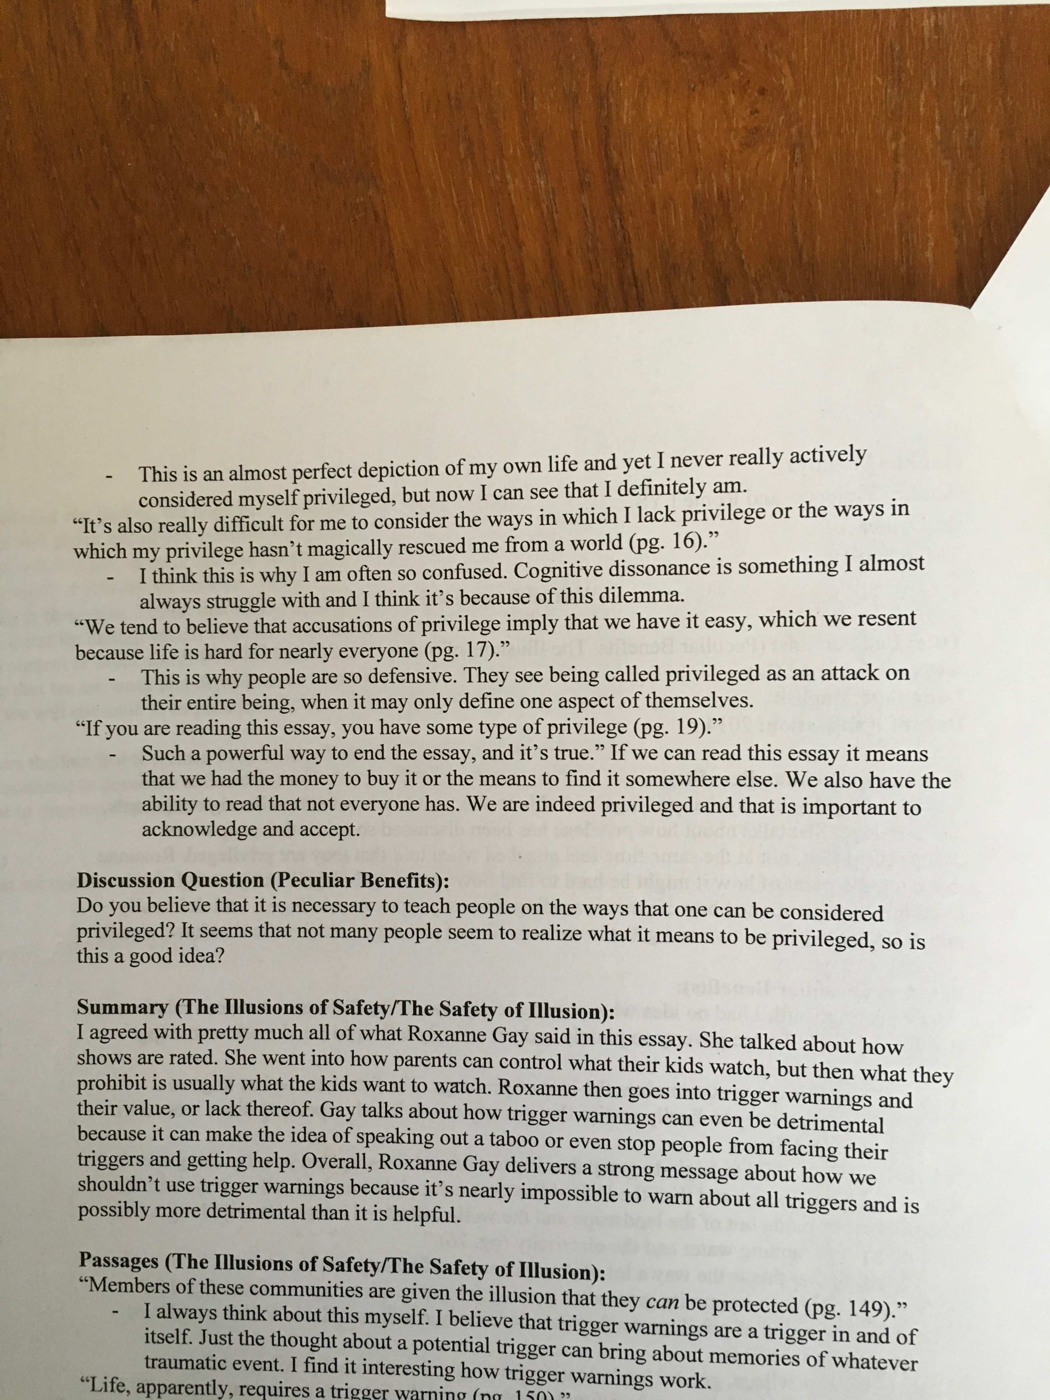
Sample Student Journals

Slide 13
Students’ topics included
Roman slavery,
questions about male sexuality, about female sexuality,
about non-binary Romans and third gender in Roman texts and in films reimagining Rome
about the Roman god Jupiter viewed through the concept of Rape Culture
about the intersections of gender and class-based oppression on the representation
of enslaved women in Roman comedy,
about virginity and legal regulations of marriage,
about the representations of racialized identities and racialized oppression
in Shakespeare’s Roman play Titus Andronicus,
about maternal authority in the Hymn to Ceres (Roman version of hymn to Demeter),
about victim blaming in Ovid’s Metamorphoses,
about women’s brand of humor in Roman comedy,
about Roman womens’ role in politics,
about the experience of sexual assault survivors,
about the need to change college curricula to help prevent gender-based violence
about Rape in Roman reality, law, and literature

Slide 14
How can we apply an intersectional approach to the study of Women in the ancient Roman world and in its Receptions?
Limits:
Responsibilities:
Knowledges:

